Slide 1
Transboundary water cooperation for integrated solutions in the Sava river basin
Dragan Zeljko, ISRBC

Slide 2
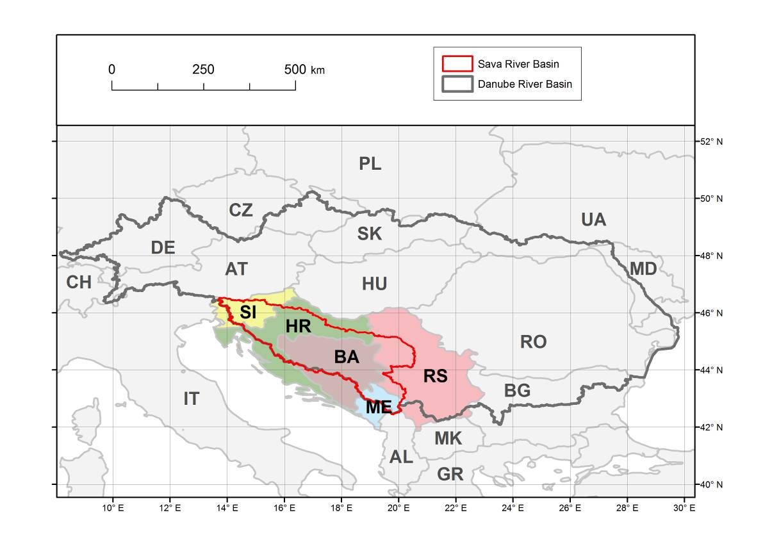
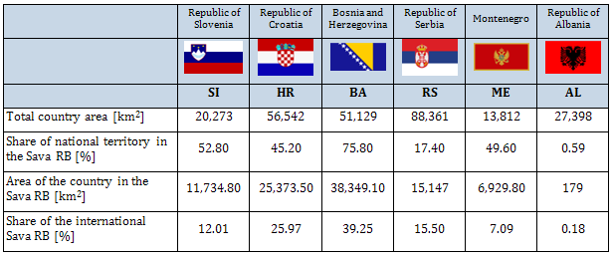
Sava river basin
Area: ≈ 97 700
Average flow at the mouth: ≈1700 m3/s (the largest Danube tributary; contribution: 25%)
River length: 945 km (≈ 600 km of which is the waterway)
Population: approx. 9 million

Slide 3
Framework Agreement on the Sava RB
Key objective:
Sustainable development of the region
through transboundary water cooperation
Particular goals – to establish:
  International regime of navigation
  Sustainable water management
  Sustainable management of hazards (floods, droughts, accidents involving water pollution, etc.)
Parties to the FASRB: BA, HR, RS and SI (ME – MoU)
Implementing body: International Sava River Basin Commission
Balanced approach needed
to use the potential and preserve the values simultaneously

Slide 4
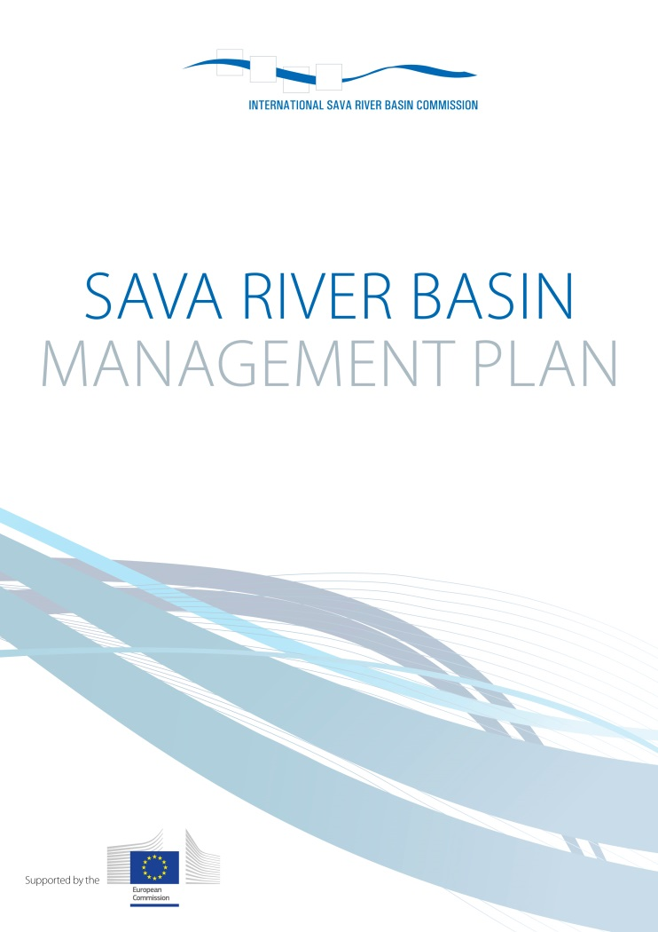
River basin management
Sava RBM Plan: Based on commonly agreed Significant Water Management Issues for the whole basin:
  Pollution (organic, nutrients, hazardous substances)
  Hydromorphological alterations and
  Groundwater quality & quantity
Other issues
  Quantity and quality aspects of sediments
  Invasive alien species
  Water demand management
Commonly agreed visions and management objectives for each SWMI
Programme of Measures (PoMs)

Slide 5
River basin management
Example: Organic pollution
Management objective for organic pollution is phasing out all discharges of untreated wastewater from towns with >2,000 population equivalents and from all major industrial and agricultural installations
Programme of Measures (3 scenarios)
  Baseline scenario (2015)
  Midterm scenario (wastewater collection and treatment in agglomerations >10,000 PE)
  Vision scenario (wastewater collection and treatment in agglomerations >2,000 PE)
The cost of the baseline scenario is estimated to 1.2 billion €
The full cost of compliance with the UWWTD for the Sava RB is estimated to 5.3 - 6 billion €, which represents 100% sanitation for settlements above 2,000 PE.

Slide 6
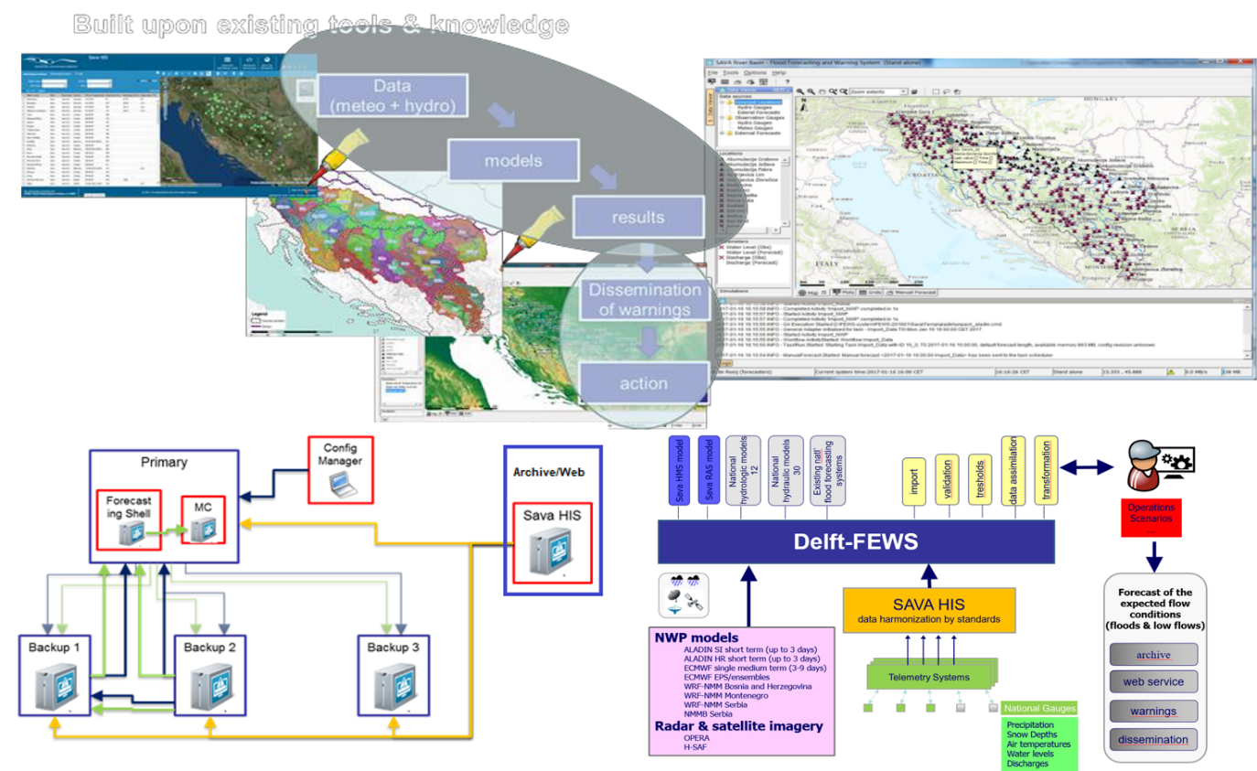
Flood Risk Management
Sava FRM Plan
  Common objectives
  251 potential flood areas of importance for Sava FRMP were identified
  These areas were further grouped into 21 Areas of Mutual Interest
  Total surface of AMIs is 5,659 km2, and a home to 1.4 million people;
  42 non-structural measures and 38 (national) structural measures in areas of mutual interest
Sava FFWS

Slide 7
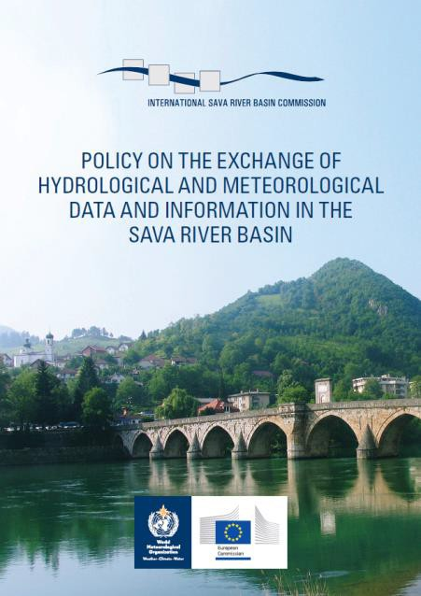
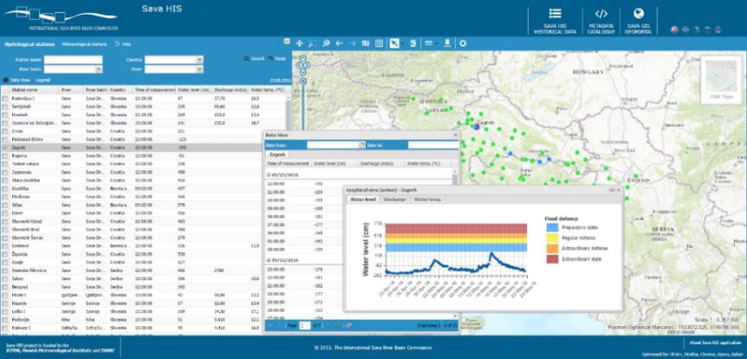
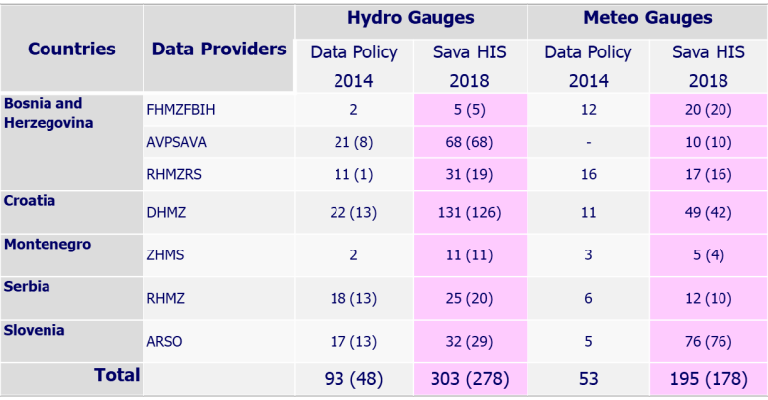
Data and information exchange
Sava GIS (www.savagis.org) and Sava HIS - www.savahis.org
  RBM, FRM and HMI related data available
  Data hub for Flood Forecasting and Warning System (FFWS)

Slide 8
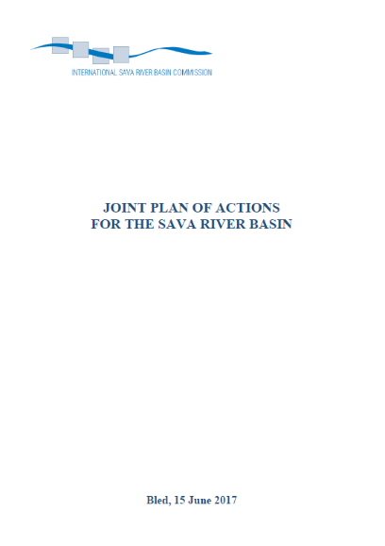
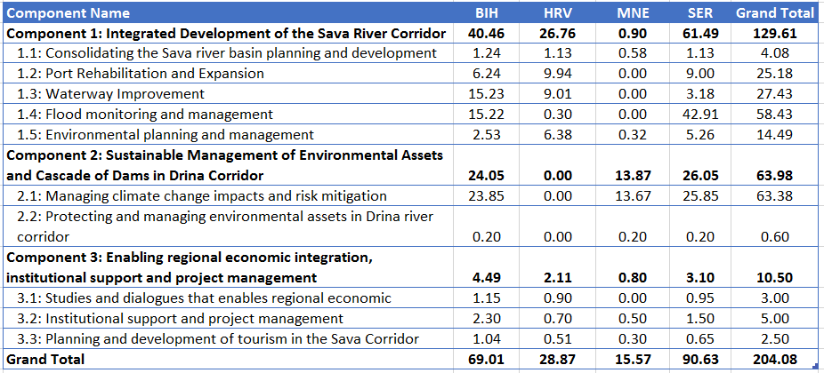
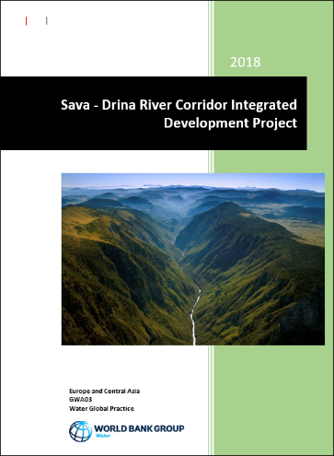
Development issues
  Joint Plan of Action (Bled, June 15 2017)
    Milestone for integrated river basin management and socioeconomic development in the region
  Sava - Drina River Corridor integrated development program (WB, 2018)
  - Aiming to foster regional integration and unlock productive investments

Slide 9

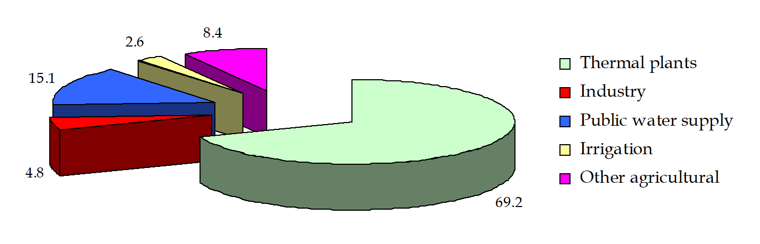
Sava Nexus
Sava Water – Food – Energy – Ecosystems Nexus Assessment
Nexus main objectives: next presentation
Objectives / expectations specific to the Sava – to contribute to:
Dialogue with sectoral stakeholders
Integration of policies
Inter-sectoral coordination
RBM planning
Notes:
These are the objectives of a nexus assessment carried out using the methodology developed under the Water Convention.
For the Sava specifically, the expectations were that the nexus assessment would help strengthening intersectoral coordination within the existing framework of transboundary cooperation.

Slide 10
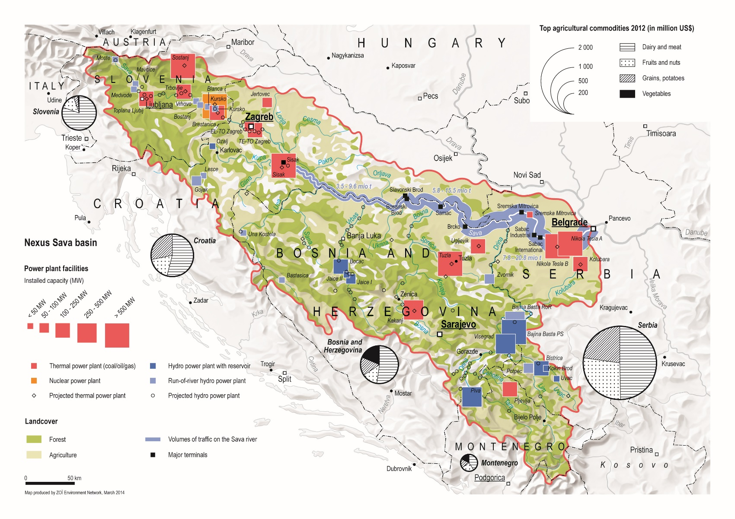
Sava: balancing different water uses with nexus approach
FLOW REGULATION
TO ACCOUNT NOT
ONLY HYDRO BUT
ALSO COOLING
THERMAL &
NUCLEAR POWER
EXPANSION OF
IRRIGATION
PLANNED
INCREASED
WATER SCARCITY
PREDICTED
NAVIGABILITY
NEEDS TO BE
ENSURED
WETLANDS SERVE FLOOD
PROTECTION
SMALL AND MEDIUM
HYDROPOWER DEVELOPMENT
ON THE TRIBUTARIES
Notes:
This slide is about different water uses, which links several of the issues illustrated before. In particular:
1) Power production in the Sava is very important for the countries (graph)
2) Water resources serve different uses (map) and energy production depends on water availability - not only hydro but also cooling for thermal production
3) This water is also needed for other uses (tradeoffs)
4) Considering the all the development needs and pressures, as well as diversity of water uses and policies outside water management that impact on the basin, an improved knowledge about the interlinkages and a stronger coordination are necessary for not to compromise sustainability
5) Reconciling climate and energy policy targets without compromising environmental and water resources sustainability (or other water uses): energy mix, co-optimize flow regulation, trade energy and balancing services, harmonize regulation etc.

Slide 11
Summary
Challenges
Differences between the countries (i.e. EU membership, languages)
Different priorities
Broad scope of work
  Demanding process (requires significant resources both in the ISRBC and in the Parties),
  Requires good inter-sectoral coordination and communication within a country
  Meeting interests of different actors (within a country / between countries)
  Need for additional regulation of specific issues (protocols to the FASRB)
Continuous commitment and support to joint processes
Approach
Integrated (whole basin, scope of work, all societal sectors)
Aligned with the international regulations and standards
Pragmatic and practical
Educative (capacity building, awareness raising)
Participatory
Complementary with the processes on the Danube & national levels

